Slide 1
Bioinformatics
1
UNIVERSITY OF BASRAH / COLLEGE OF SCIENCE
1 Goal
2
Scope
3
Applications
Prof.Dr. Saad S. Mahdi Al-Amara
4
Limitations
LECTURE PhD. 1

Slide 2
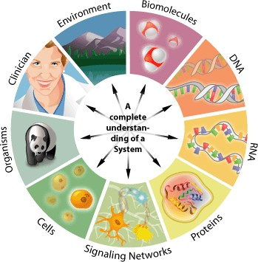
Concept of Bioinformatics
2
Bioinformatics :
An emerging interdisciplinary research area .
deals with the computational management and analysis of biological information: genes, genomes, proteins, cells, ecological systems, medical information, robots, artificial intelligence…
Biologists are increasingly finding that the management of complex data sets is becoming a bottleneck for scientific advances. Therefore, bioinformatics is rapidly become a key technology in all fields of biology.

Slide 3
Concept of Bioinformatics
3
Goals
1
The ultimate goal of bioinformatics is to better understand a living cell and how it functions at the molecular level.
2
Functions of a cell can be better understoodby analyzing sequence data .
Scop
Development of computational tools and databases
1
2
application of these tools and databases in generating biological knowledge to better understand living systems.

Slide 4
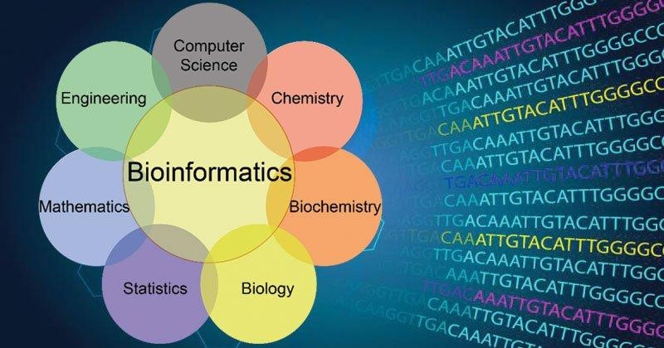
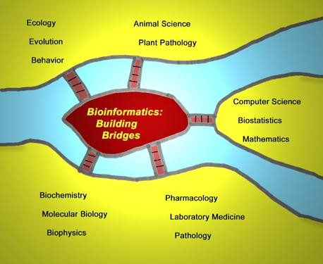
Concept of Bioinformatics
4
Bioinformatics (Oxford English Dictionary):
The branch of science concerned with information and information flow in biological systems, esp. the use of computational methods in genetics and genomics.

Slide 5
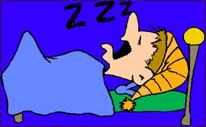
Concept of Bioinformatics
5
Biologists
collect molecular data: DNA & Protein sequences, gene expression, etc.
The field of science in which biology, computer science and information technology merge into a single discipline
Bioinformaticians
Study biological questions by analyzing
molecular data
Computer scientists (Mathematicians, Statisticians, etc.) Develop tools, softwares, algorithms to store and analyze the data.
In the end
A biologist
5

Slide 6
Concept of Bioinformatics
6
Informatics Skills:System Design & Implementation
Data Production
&
Data Gathering
Problem Determination User Requirements
DESIGN
User Interface
System Configuration & Maintenance
System
Algorithms
DEVELOP
Data Distribution
Usage & Outcomes
Results &
Interpretation
EVALUATE

Slide 7
Application of Bioinformatics
7
The various subfields of bioinformatics that include:
Biocomputing tool development is at the foundation of all bioinformatics analysis.
The applications of the tools fall into three areas including :
Sequence analysis.
Structure analysis.
Function analysis.

Slide 8
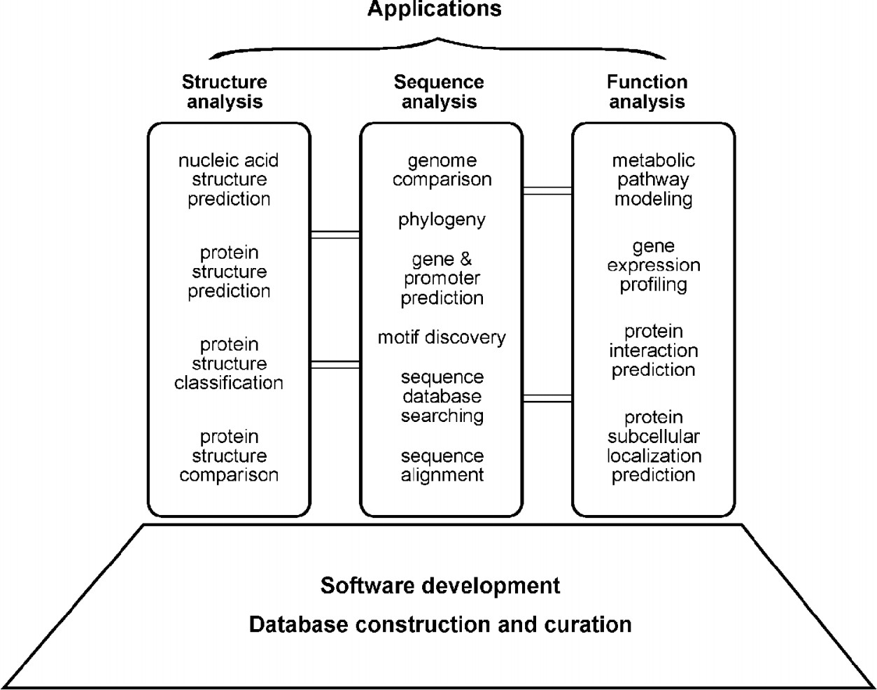
Application of Bioinformatics
8

Slide 9
Limitation of Bioinformatics
9
Bioinformatics depends on experimental science to produce raw data for analysis. It, in turn, provides useful interpretation of experimental data and important leads for further experimental research.
Bioinformatics predictions are not formal proofs of any concepts. They do not replace the traditional experimental research methods of actually testing hypotheses.

Slide 10
Limitation of Bioinformatics
10
In addition, the quality of bioinformatics predictions depends on the quality of data and the sophistication of the algorithms being used. Sequence data from high throughput analysis often contain errors. If the sequences are wrong or
Annotations incorrect, the results from the downstream analysis are misleading as well. That is why it is so important to maintain a realistic perspective of the role of bioinformatics.

